Slide 1

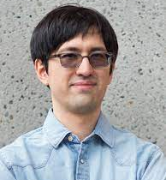
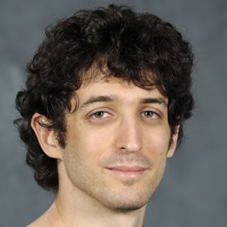



Neural Progressive Meshes
Yun-Chun Chen^{1,2}
Vladimir G. Kim²
Noam Aigerman²
Alec Jacobson^{1,2}
1
2

Slide 2
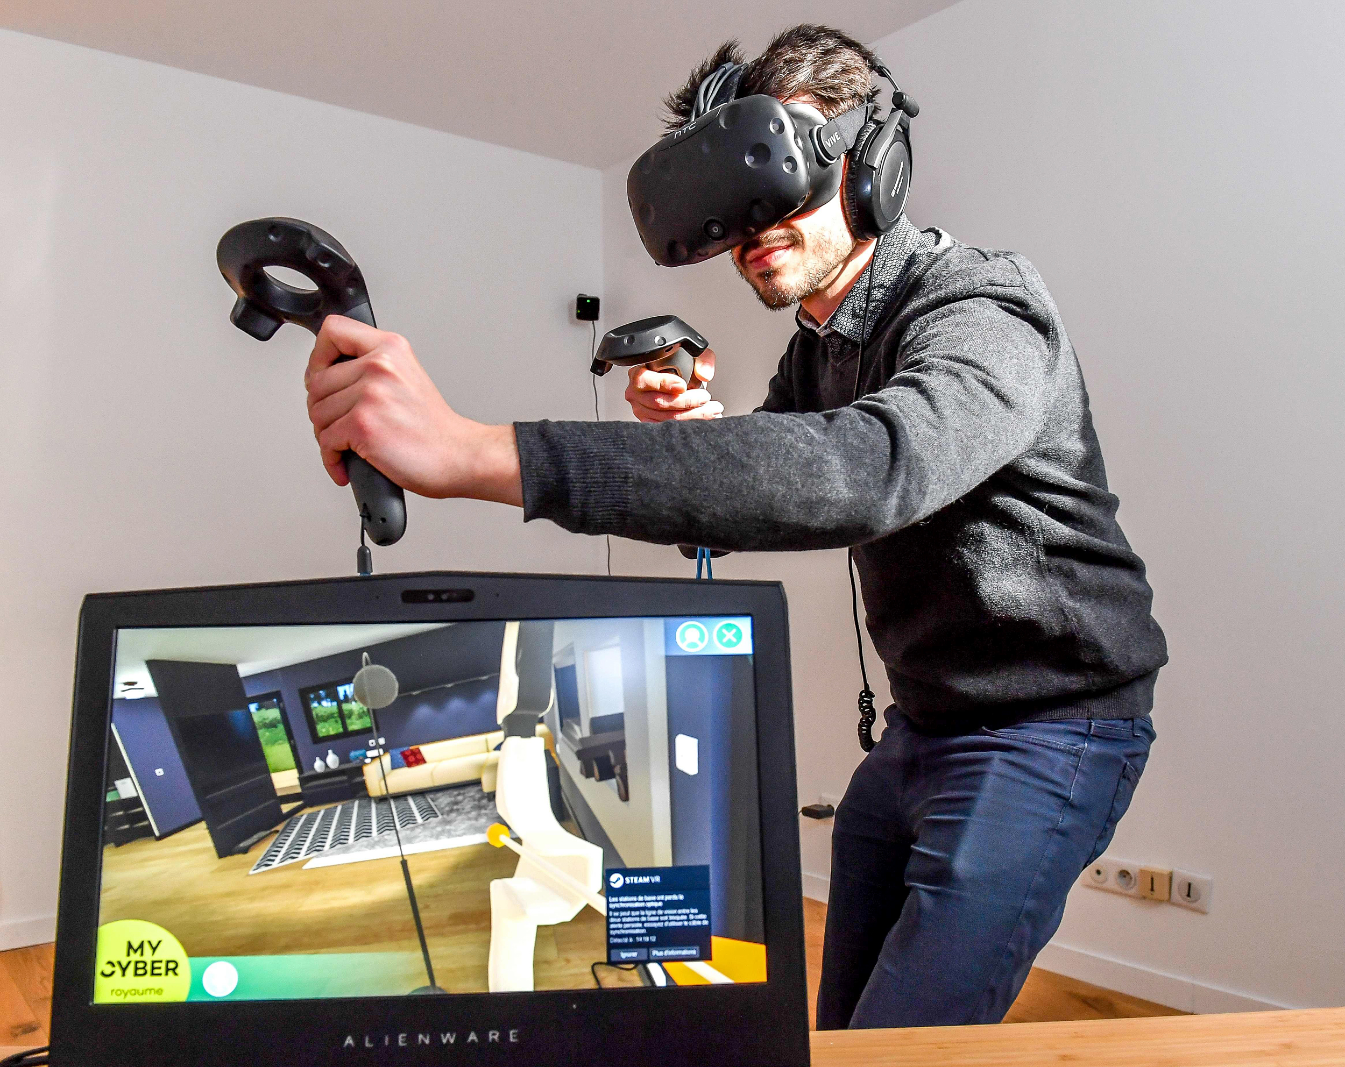
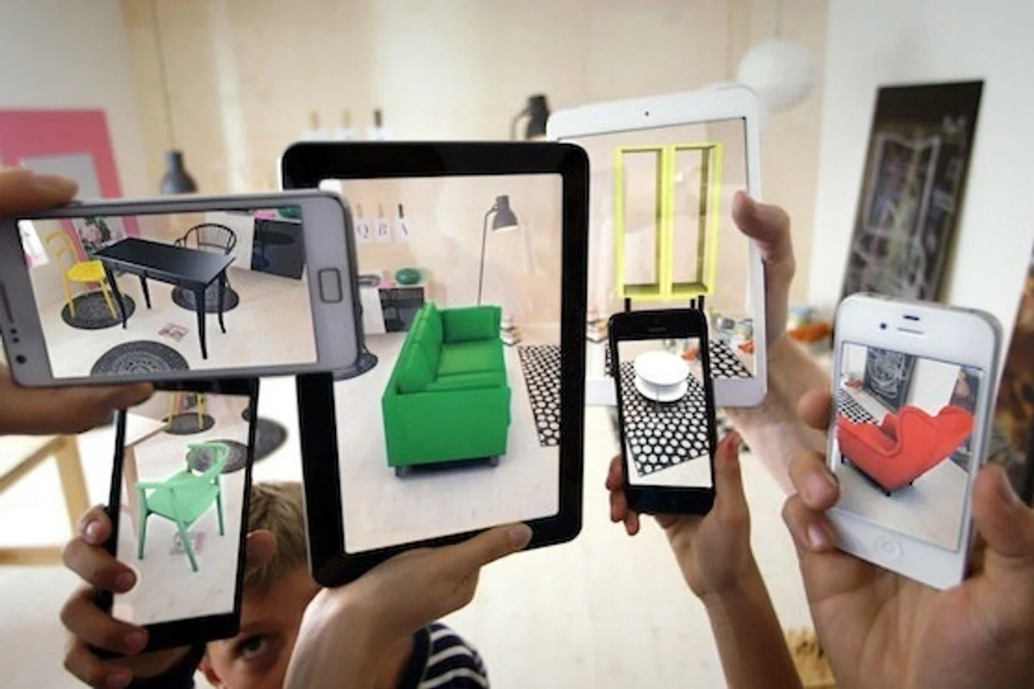
Applications
Virtual Reality
Augmented Reality
Image credits: Getty Images (left) & IKEA (right)

Slide 3
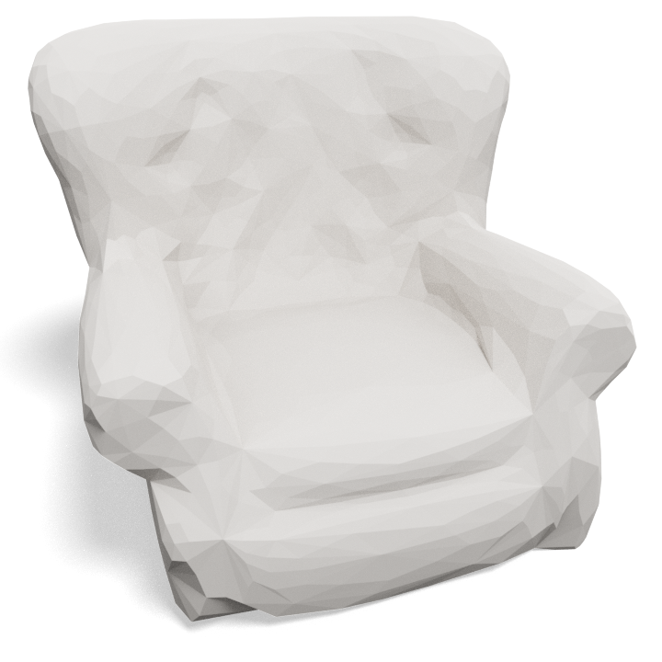
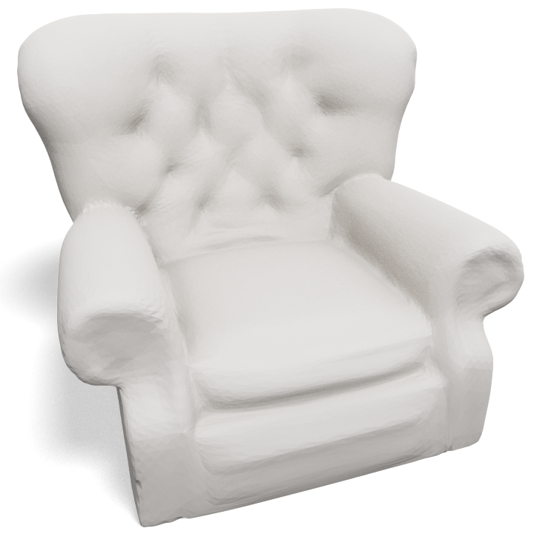
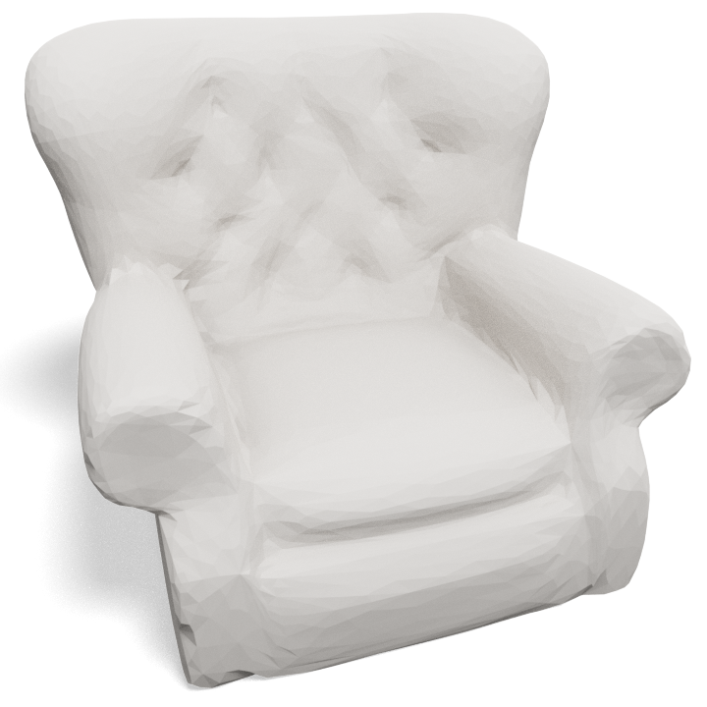


Transmitting 3D Assets
Data
Data
Server
Client
Image credits: Polantis & icons8

Slide 4
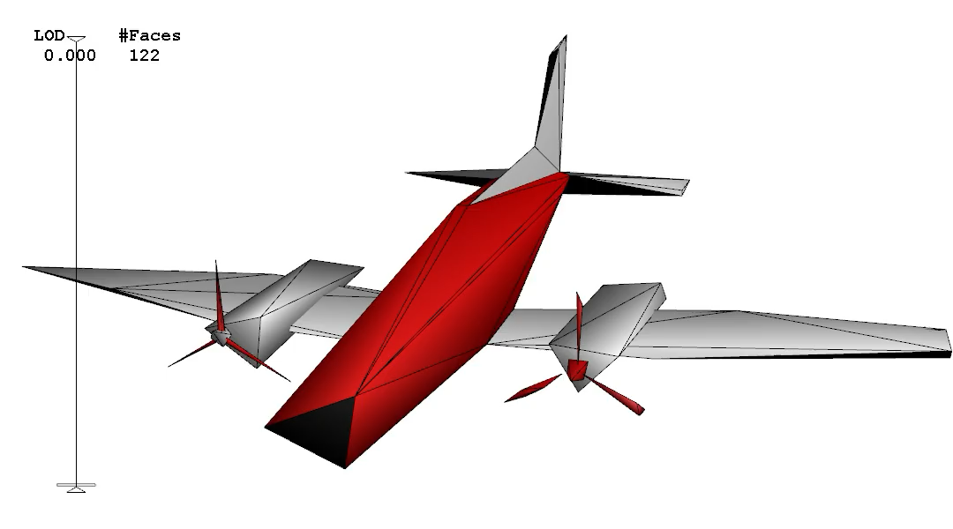
Progressive Meshes
Video credit: [Hoppe 1996]

Slide 5
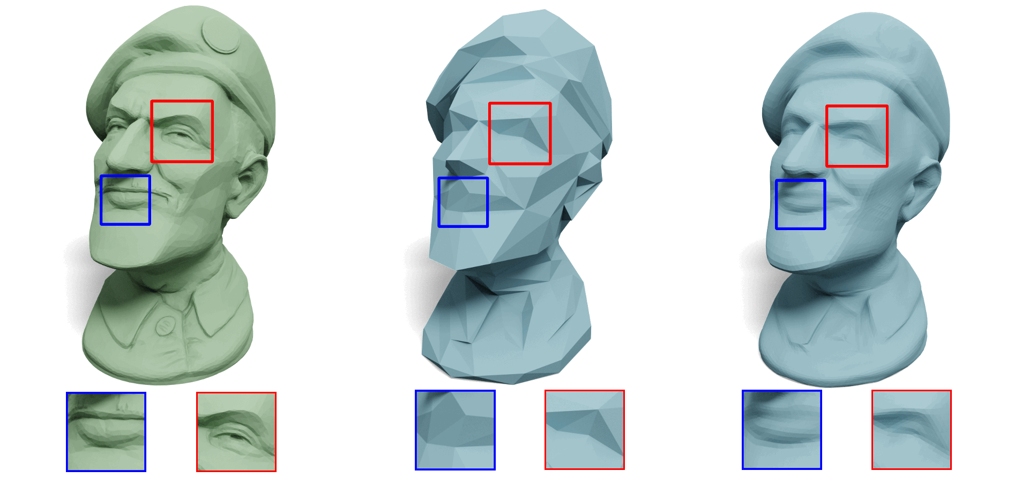
Our Work: Neural Progressive Meshes

Slide 6
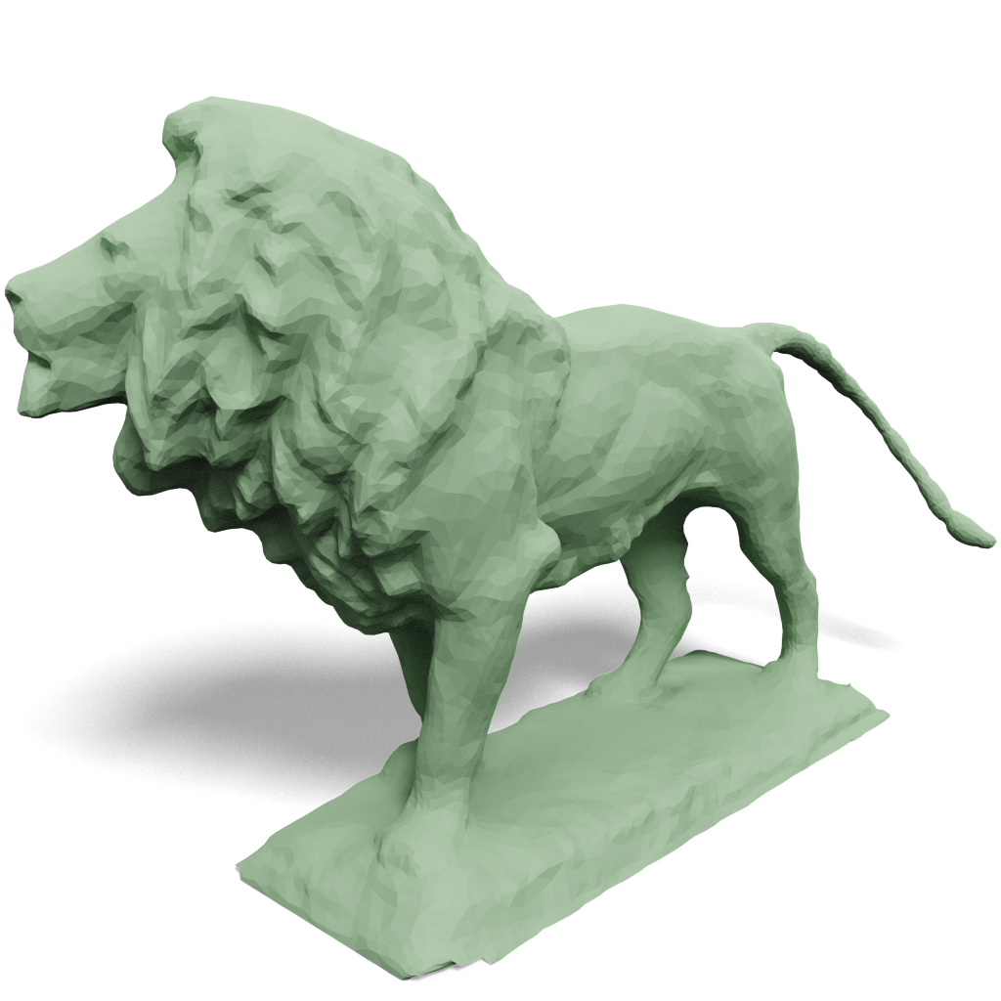
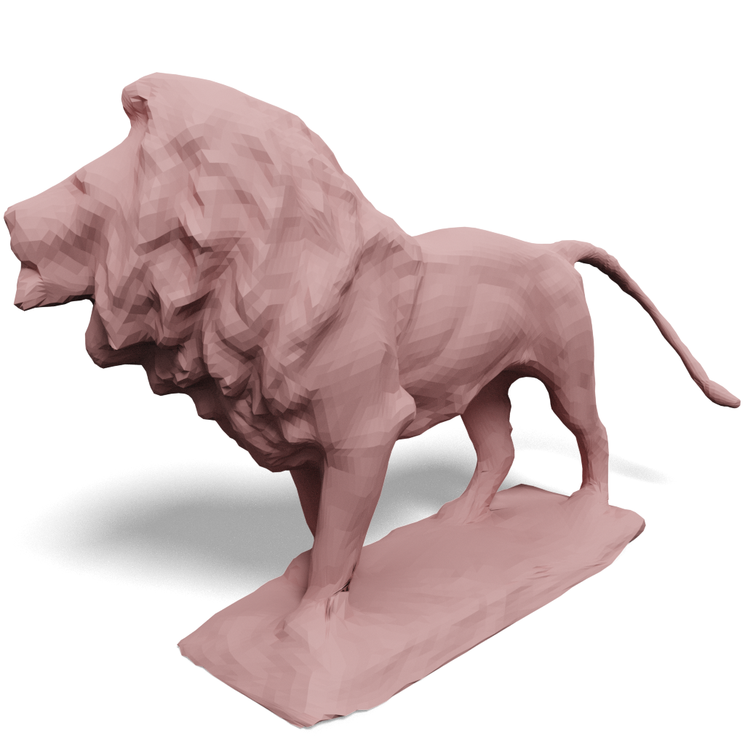
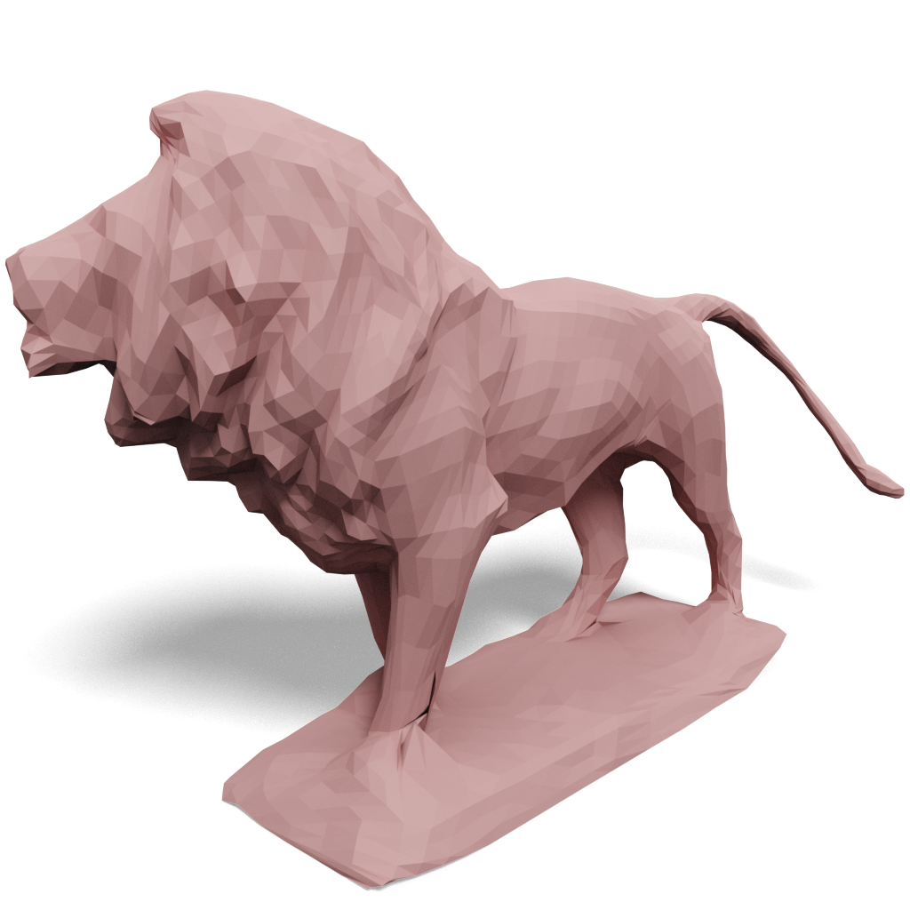
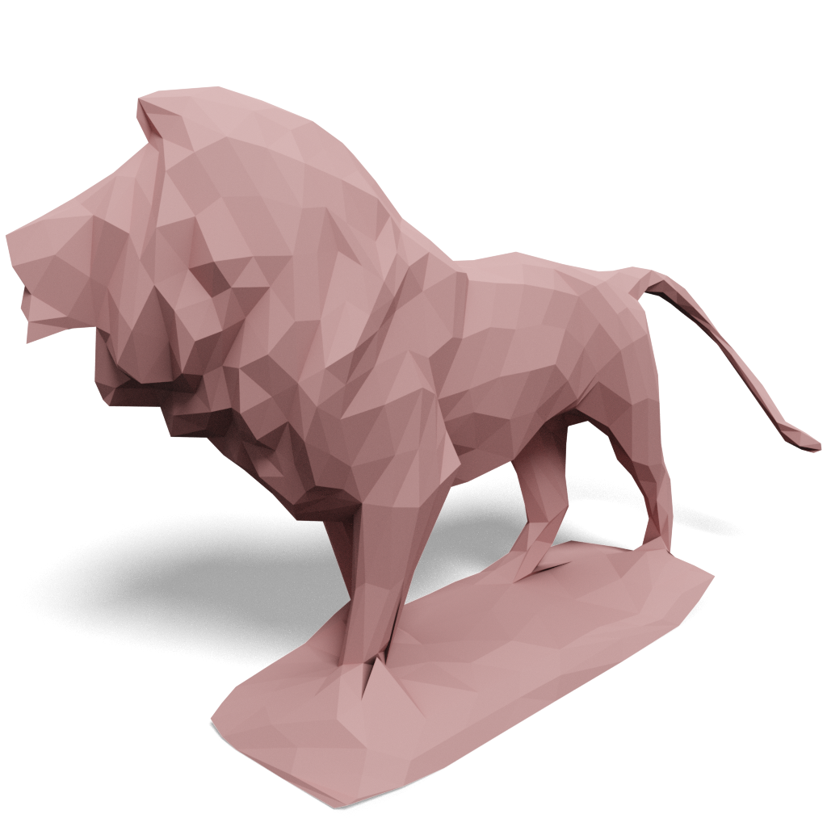
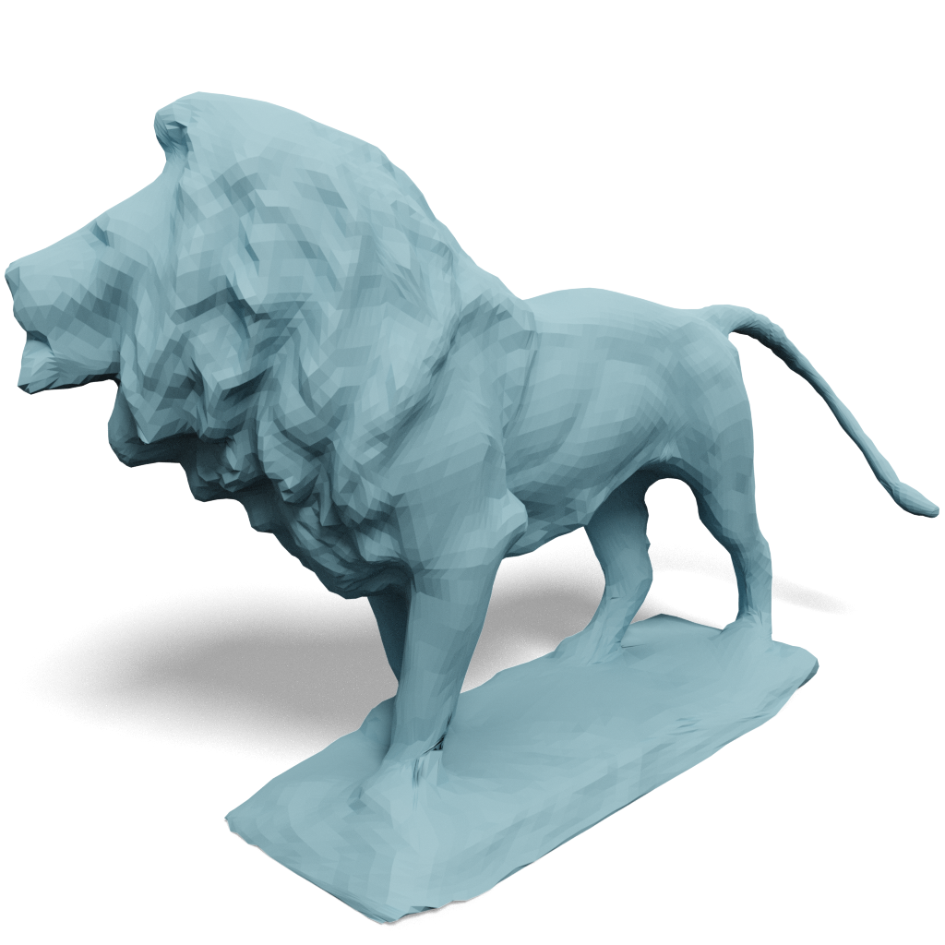
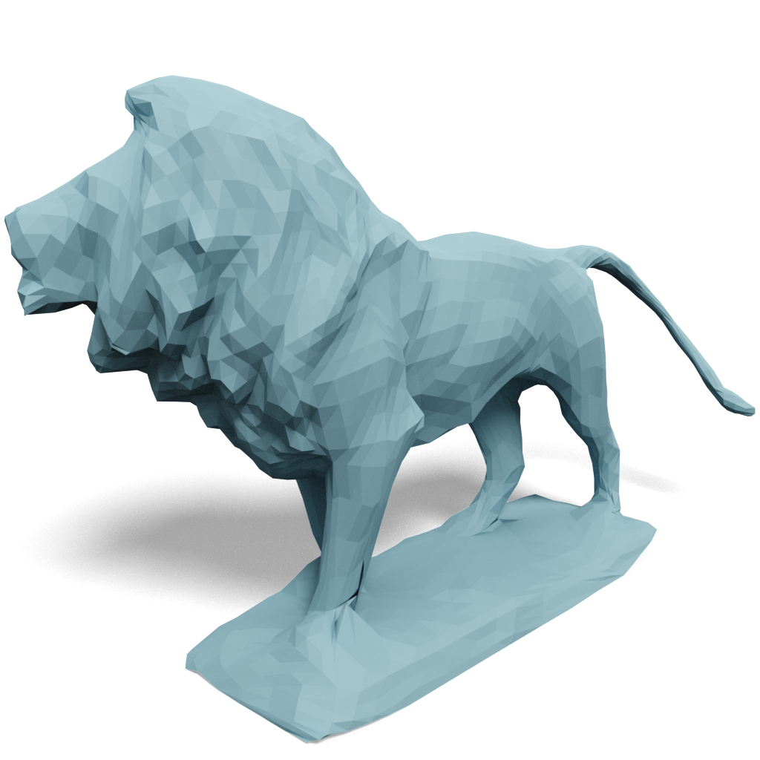
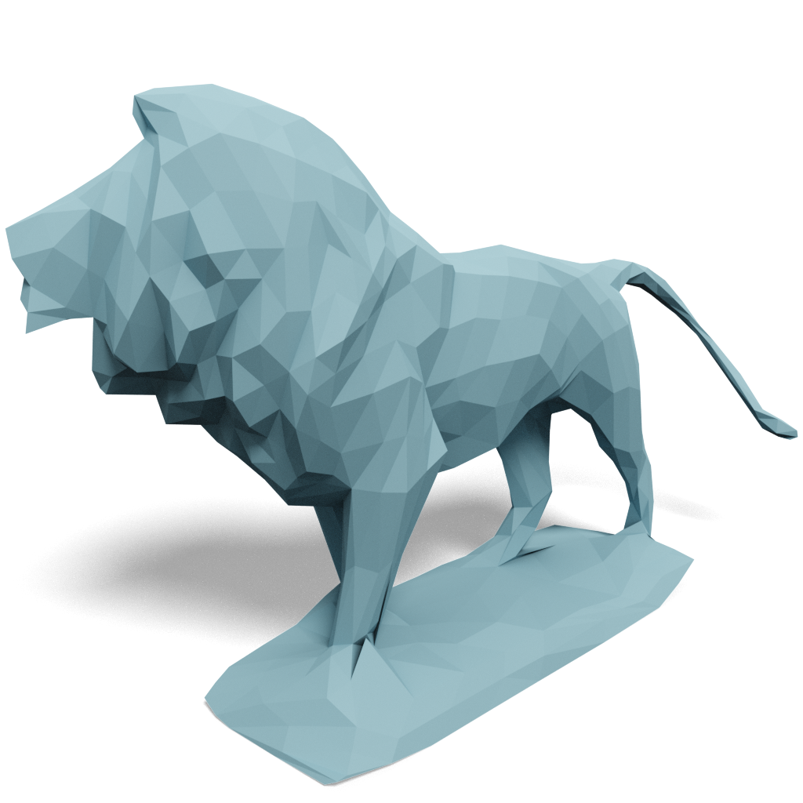
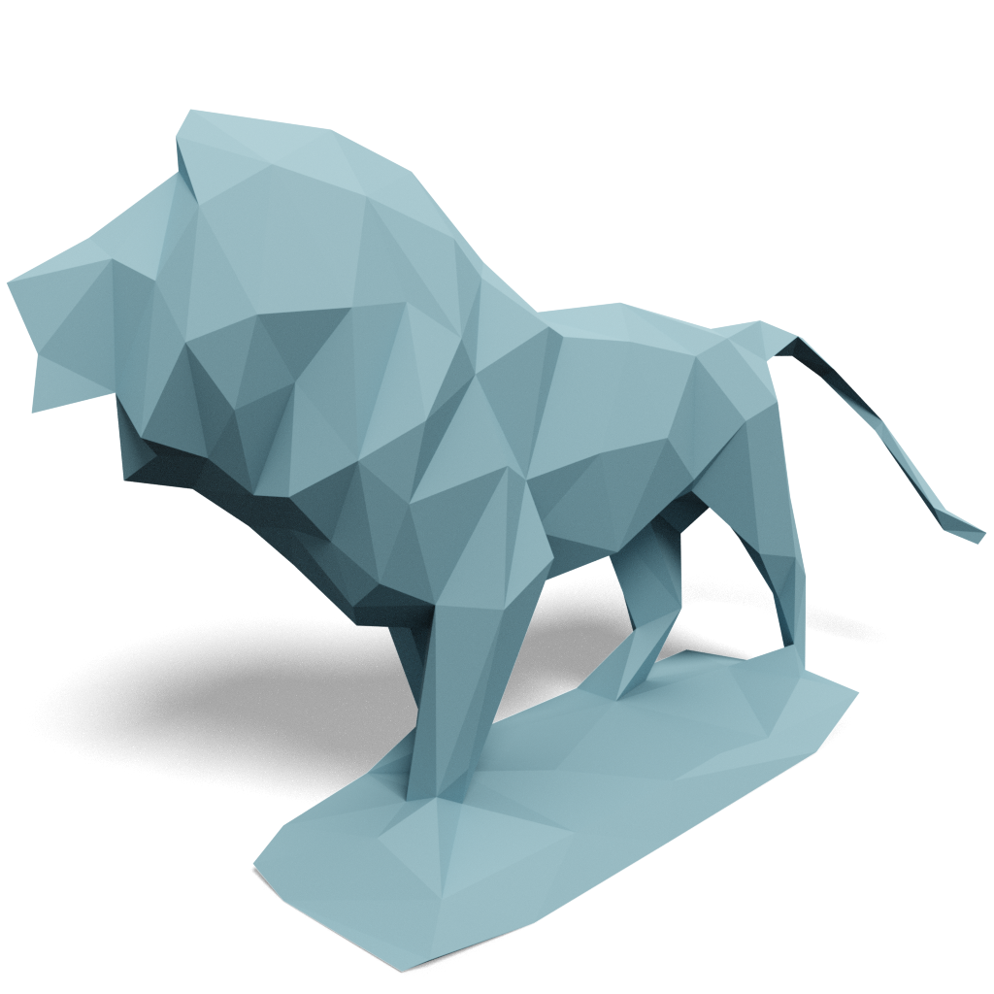
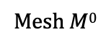
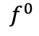
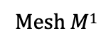
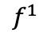
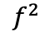
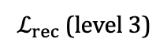
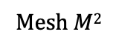
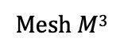
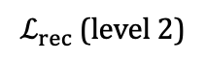
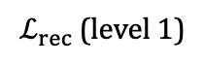
Network
Mesh $M$³
Mesh $M$²
Mesh $M$¹
Remeshing
E
E
$$f^{1}$$
E
Input mesh M
$$f^{2}$$
$$f^{0}$$
D
D
D
$ℒ_{rec}$(level 3)
$ℒ_{rec}$ (level 2)
$ℒ_{rec}$ (level 1)
Mesh $M$⁰

Slide 7
Encoder
Mesh $M$³
Mesh $M$²
Mesh $M$¹
Remeshing
E
E
$$f^{1}$$
E
Input mesh M
$$f^{2}$$
$$f^{0}$$
conv
pooling

Slide 8
Decoder
D
D
D
$ℒ_{rec}$(level 3)
$ℒ_{rec}$ (level 2)
$ℒ_{rec}$ (level 1)
Mesh $M$⁰

Slide 9
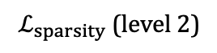

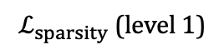
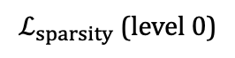
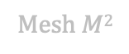

Transmitting Sparse Features
Mesh $M$³
Mesh $M$²
Mesh $M$¹
Remeshing
E
E
$$f^{1}$$
E
Input mesh M
$$f^{2}$$
$$f^{0}$$
$ℒ_{sparsity}$ (level 2)
$ℒ_{sparsity}$ (level 1)
$ℒ_{sparsity}$ (level 0)
D
D
D
$ℒ_{rec}$(level 3)
$ℒ_{rec}$ (level 2)
$ℒ_{rec}$ (level 1)
Mesh $M$⁰

Slide 10
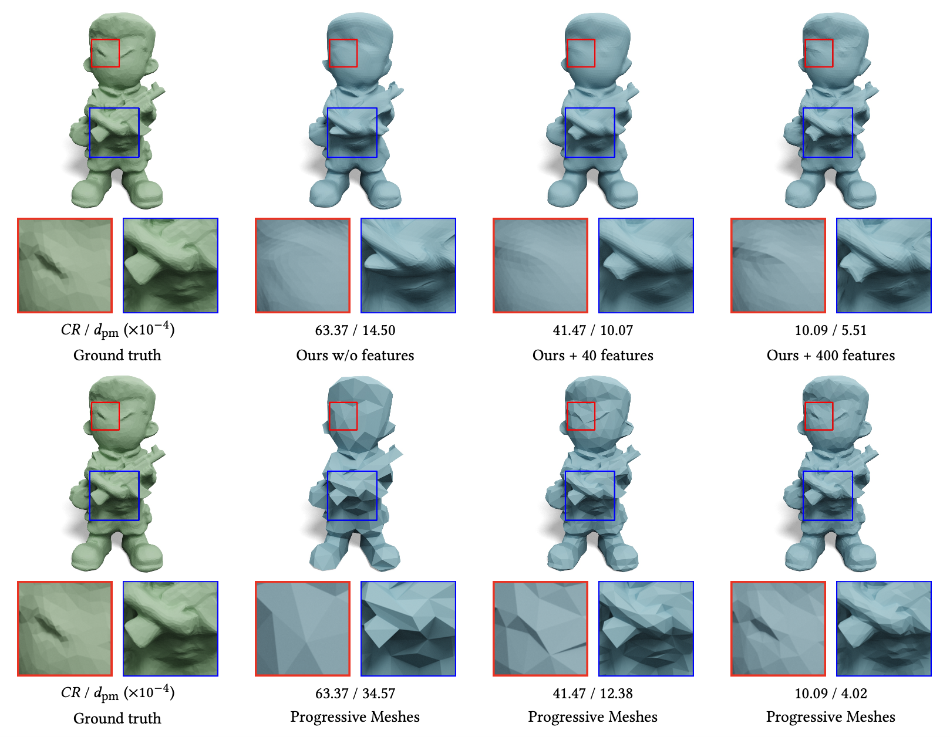
Progressive Features

Slide 11
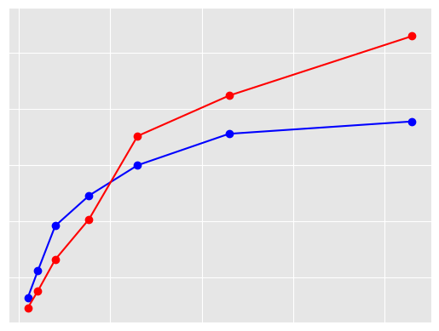
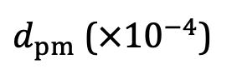
Progressive Features
$d_{pm}$ ($×{10}^{−4}$)
25
20
Progressive Meshes
Ours
15
10
5
0
10
20
30
40
Compression ratio

Slide 12
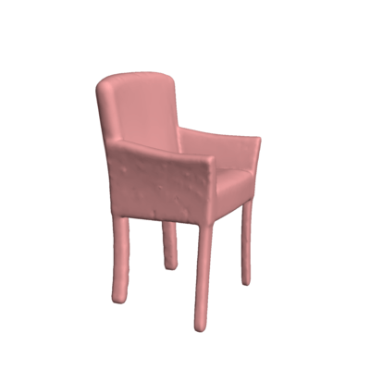
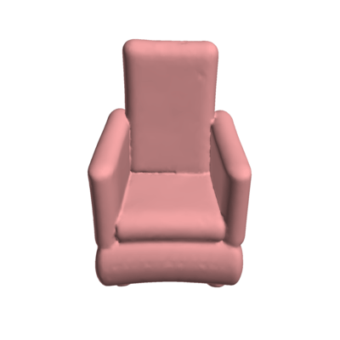
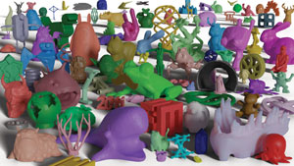

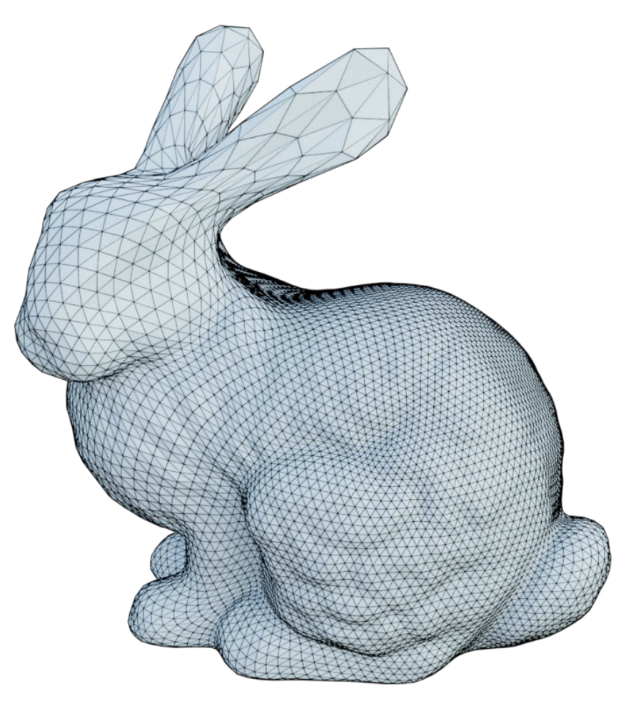
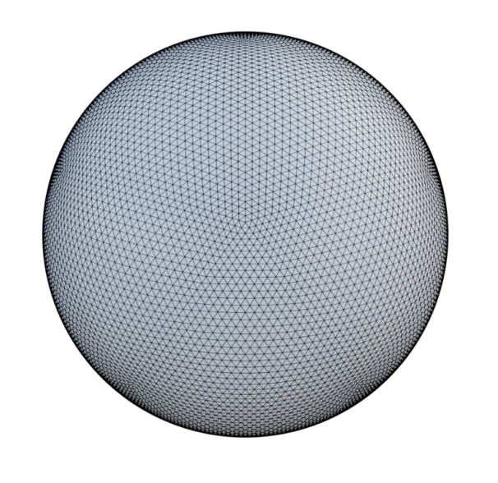
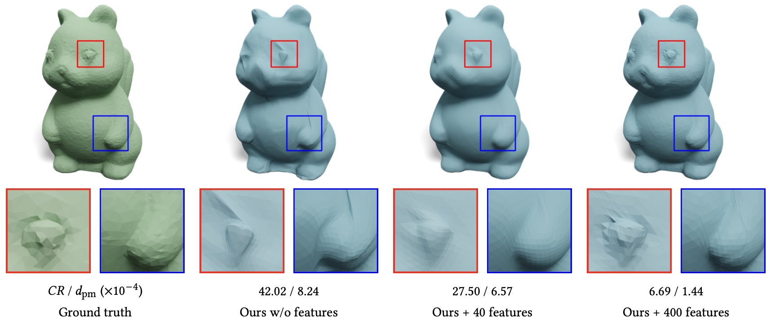
Future Work
Conclusions
- Neural nets to compress shapes
- Controllable generative tools
- Effective aggressive compression
Image credits: icon8, [Davies 2021], [Liu 2021], [Nicolet 2021]

